Slide 1
Almost all you need to know about your kidneys
What do your kidneys do?
Make urine
Regulate salt and water in your body, making about 3-4 pints of urine each day
Remove waste products from your blood into your urine
Produce hormones
Regulate your blood pressure
Create hormones to control the production of red blood cells
Activate Vitamin D
For healthy bones
Clean your blood
Eliminate medication/food waste

Slide 2
What can cause kidney problems?
High blood pressure
Blockages – stones,
Inflammation – gout
Dehydration
Medication – ibuprofen, diclofenac, naproxen
Diabetes
Genetics

Slide 3
Symptoms poor Kidney Health
Early stages – none
Severe - Tiredness • Frequent headaches • Loss of appetite • Sleep problems • Itchy skin • Nausea or vomiting • Swelling or numbing of the hands or feet • Passing urine more (especially at night) or less often than usual • Darkening / lightening of the skin • Muscle cramps

Slide 4
How can you keep our kidneys healthy?
Keep hydrated – your urine should be a very pale yellow colour
SICKDAY Rules – it is advised that certain medication be stopped for 1-2 days during illness only on advice of GP (do not stop any medication unless advised)
Stop smoking
Healthy weight – balanced diet
Reduce your intake of salt, processed foods and high sugar drinks

Slide 5
What do we do in the practice
Invite you to a Kidney Health Check appointment
Monitor kidney Health
How do we measure kidney health – blood test and urine test
Manage Blood Pressure
Manage Gout
Reduce risk of a heart attack or stroke by offering aspirin and statin
Adjust medication appropriate to your kidney function – correct dose, stop, alternative

Slide 6
For more information visit Think Kidneys website
How to Keep your Kidneys Safe:
https://www.thinkkidneys.nhs.uk/aki/wp-content/uploads/sites/2/2016/02/BKPA-Patient-at-Risk-Leaflet_Printout.pdf
How to Prevent an Acute Kidney Injury
https://www.thinkkidneys.nhs.uk/aki/wp-content/uploads/sites/2/2015/11/BKPA-RCGP-A4-Printout-Plain-Leaflet_v2.pdf
Think Kidneys infographic
https://www.thinkkidneys.nhs.uk/aki/wp-content/uploads/sites/2/2017/12/Think-Kidneys-Infographic-030316-campaign-final.pdf

Slide 7
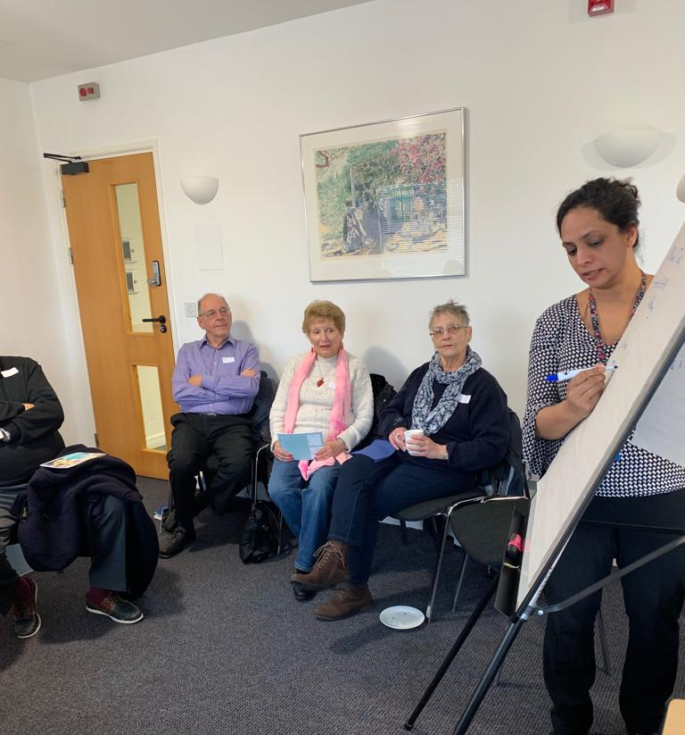
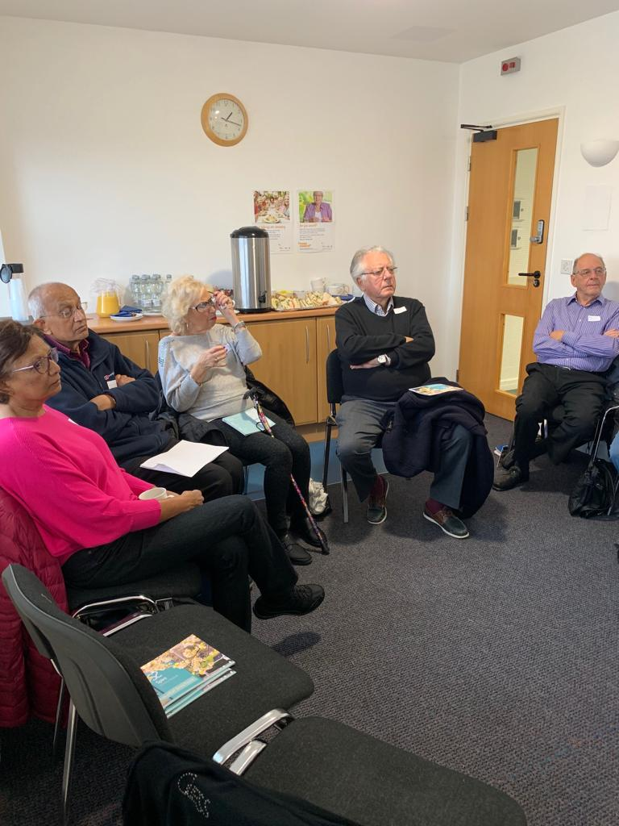
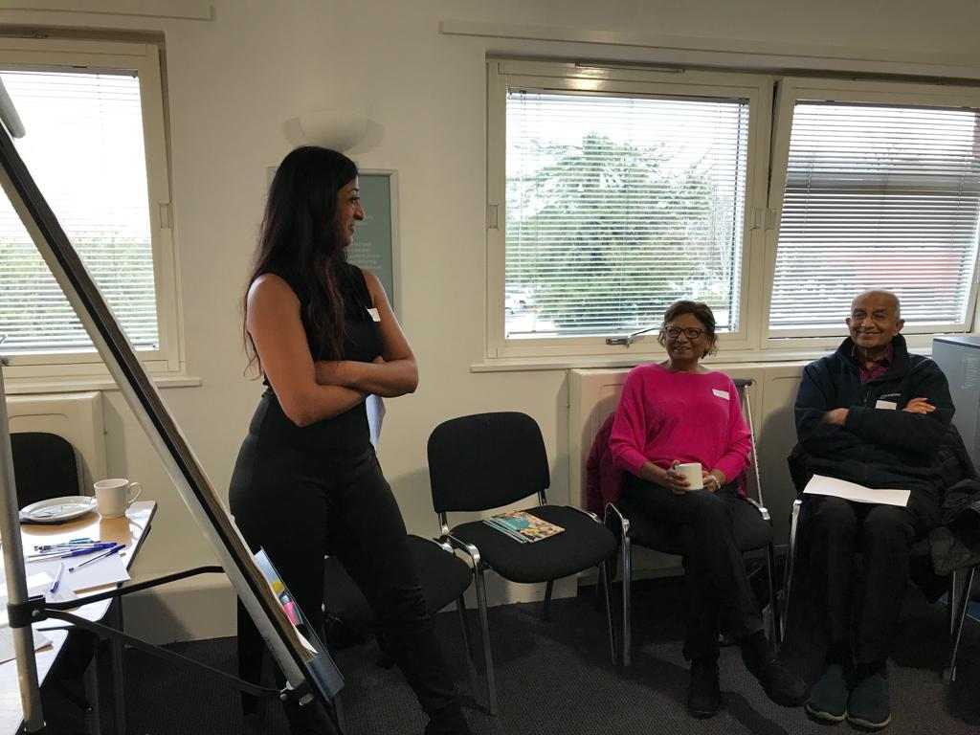
Kidney Forum
Dec 2018

